Slide 1
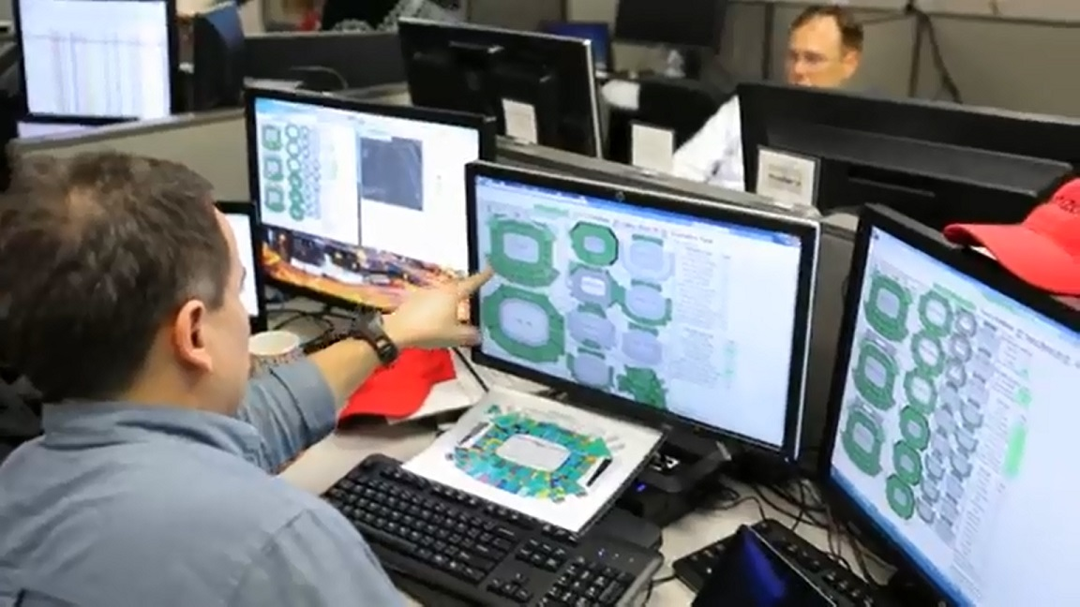
Proactively Detect & Fix
Before Customer Notices

Slide 2
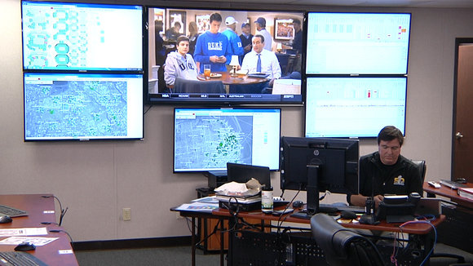
System Performance Engineer in Action

Slide 3
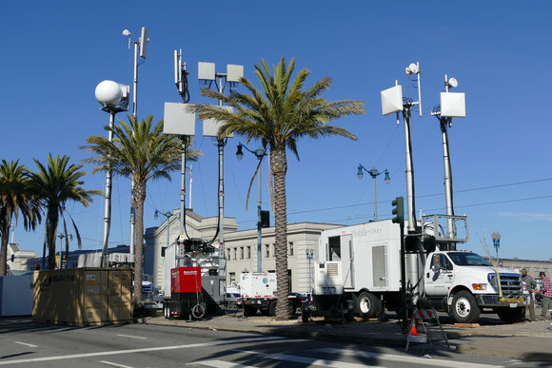
COWs, COLTs & GoATS

Slide 4
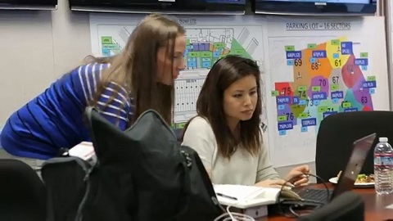

Slide 5
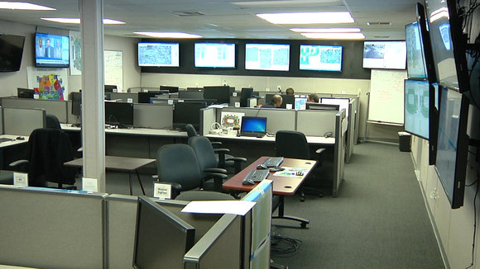
Special Events Command Center

Slide 6
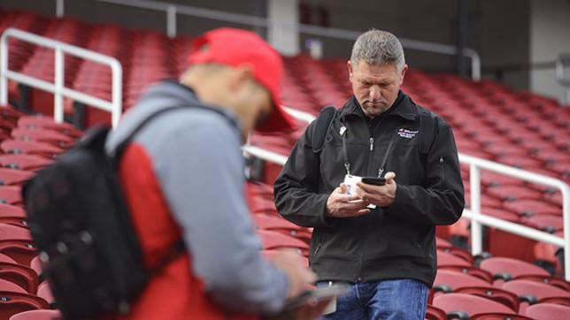
Network Test Walkers
Pre-Game Prep

Slide 7
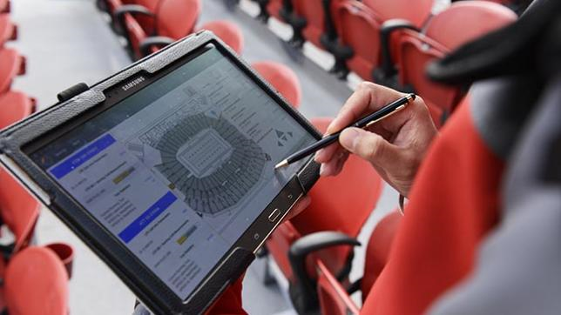
Track Down Issues
In the Stadium

Slide 8
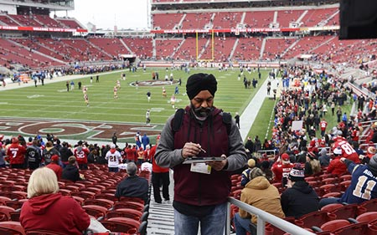
Test Walkers
during Pre-Games

Slide 9
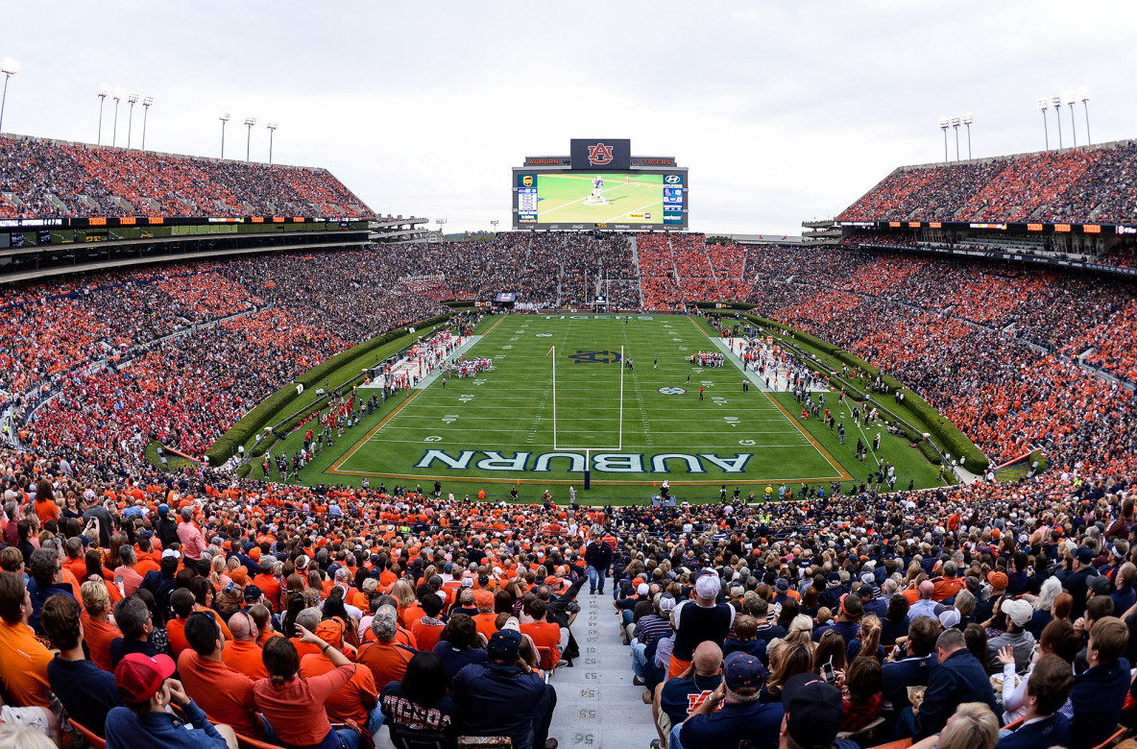
Monitor Network Performance

Slide 10
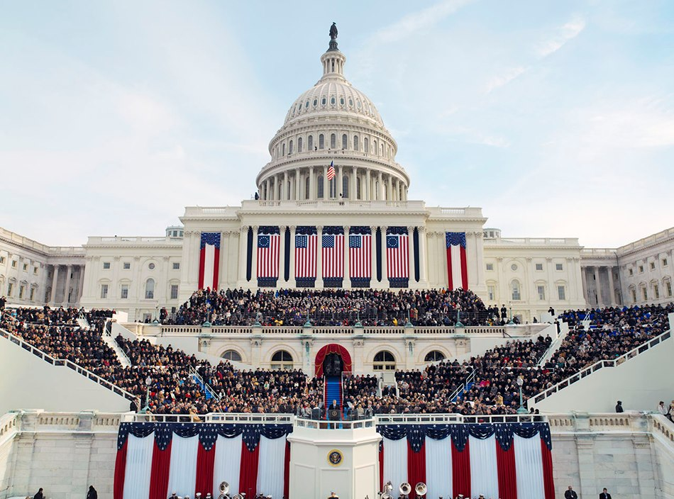
Presidential
Inauguration

Slide 11
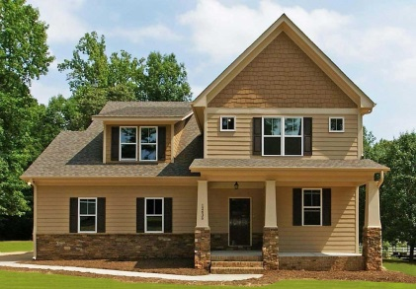

Slide 12
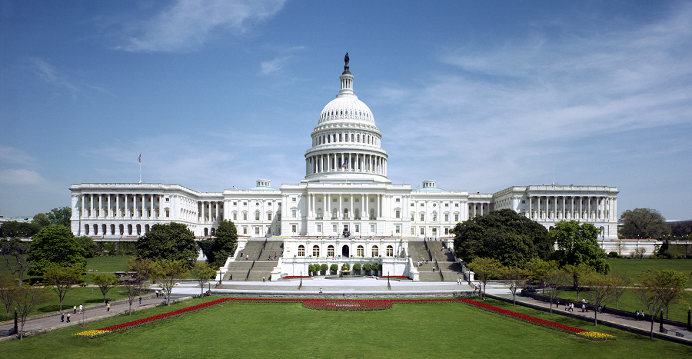

Slide 13
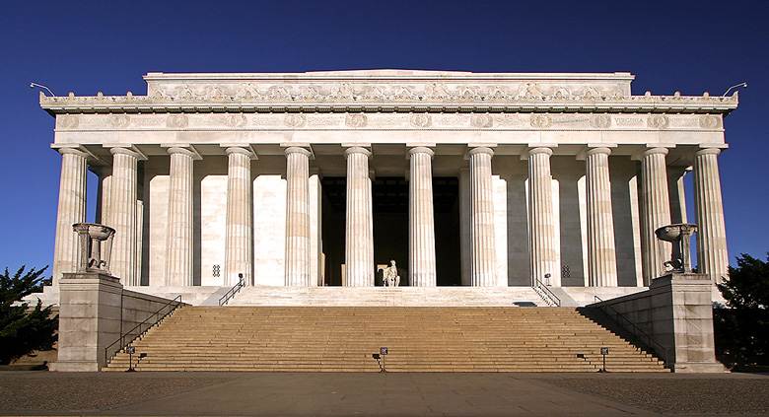

Slide 14


Slide 16


Slide 18
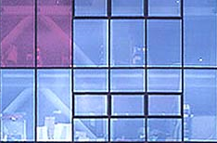

Slide 20


